Slide 1

HOSPITAL PATIENT CARE OPERATIONS ANALYTICS
A DATABASE USING MYSQL
PRESENTED BY :
KOTA PRASHANTH YADAV

Slide 2
ABOUT ME
KOTA PRASHANTH YADAV
B-TECH
DATA SCIENCE
Work Experience : Fresher
LinkedIn :
GitHub :

Slide 3
Introduction & Why This Project? :
Introduction
SQL-based hospital operations analytics project
Relational database designed using MySQL
Analysis of patient and appointment activities
Evaluates treatment performance
Examines doctor workload and room utilization
Converts operational data into meaningful insights
Why This Project?
Hospitals generate large amounts of operational data
Raw data is difficult to analyze manually
Patient demand varies across categories
Waiting time and treatment efficiency need monitoring
Doctor and room workloads can differ
Cancellations, no-shows and rescheduling affect operations
SQL helps convert data into actionable insights

Slide 4
OBJECTIVE OF THE PROJECT :
To analyze patient and appointment demand based on cities, patient types, service types, priorities, and booking channels.
To understand patient appointment behavior by identifying repeated appointments and comparing patient activity across different categories.
To evaluate treatment performance using treatment duration, waiting time, treatment attempts, and treatment outcomes.
To analyze doctor and room performance by examining doctor workload, ratings, room usage, and equipment utilization.
To identify operational problems and generate business insights related to cancellations, no-shows, rescheduling, waiting times, and treatment outcomes to support data-driven decision making.

Slide 5
Database Structure :
DATABASE = “CAREPLUS_HSPTL”
TABLES AND THEIR DETAILS ARE AS FOLLOWS:
The database contains five major relational tables: PATIENTS, ROOMS, DOCTERS, APPOINTMENTS, and TREATMENTS.
Connected with Primary And Foreign keys.
TABLE NAME | COLUMNS PRESENT
PATIENTS | PATIENT_ID,PATIENT_NAME, AGE, GENDER, CITY, PATIENT_TYPE, PREFERRED_TIME_SLOT,REGISTRATION DATE.
ROOMS | ROOM_ID,ROOM_TYPE,FLOOR,EQUPIMENT_TYPE,CAPACITY,LAST_MAINTAINANCE_DATE,IS_AVAILABLE.
DOCTERS | DOCTER_ID,DOCTER_NAME,SPECIATLITY,HIRE_DATE,RATING,EMPLOYMENT_TYPE,IS_ACTIVE.
APPOINTMENTS | APPOINTMENTS_ID,PATIENT_ID,APPOINTMENT_DATE,DOCTER_ID,SERVICE_TYPE,PRIORITY,ESTIMATED_COST,BOOKING_CHANNEL.
TREATMENTS | TREATMENT_ID,DOCTER_ID,APPOINTMENT_ID,ROOM_ID,ACTUAL_TREATMENT_DATE,TREATMENT_ATTEMPT.TREATMENT_DURATION_MIN,WAITING_TIME_MIN,TREATMENT_COST

Slide 6
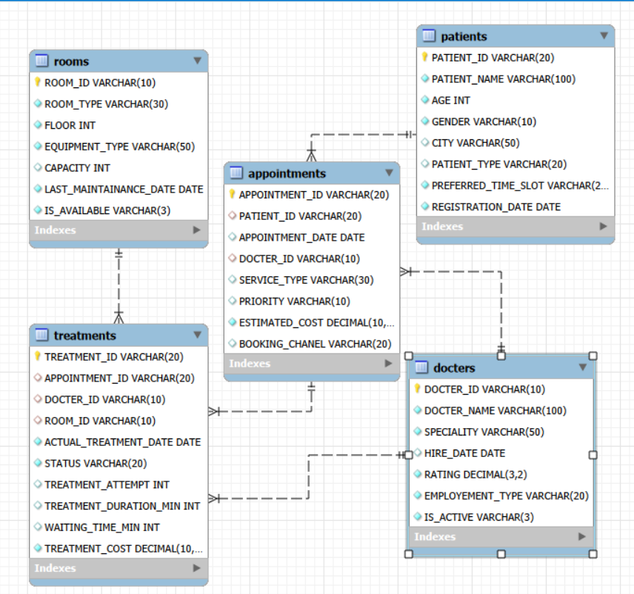
ER-DIAGRAM :

Slide 7
PROBLEM STATEMENT :
Hospitals generate large volumes of operational data.
Raw data alone does not clearly show operational performance.
Difficult to identify:
  Patient and appointment demand
  High-demand services and priorities
  Patient appointment behaviour
  Treatment waiting time and duration
  Doctor workload
  Room and equipment utilization
  Cancellations, no-shows and rescheduling
  Multiple treatment attempts
Need a structured SQL-based system to analyze data and generate actionable insights.

Slide 8
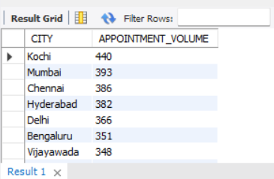
Key Analysis Questions :
1. Understand Patient and Appointment Demand
● Compare appointment volume across cities.
Query :
Output :
● City-wise demand: Appointment volume varies across cities, indicating that some locations have higher patient demand and may require greater operational capacity.
SELECT P.CITY,
COUNT(A.APPOINTMENT_ID) AS APPOINTMENT_VOLUME
FROM PATIENTS P JOIN APPOINTMENTS A
ON P.PATIENT_ID = A.PATIENT_ID
GROUP BY P.CITY ORDER BY APPOINTMENT_VOLUME DESC;

Slide 9
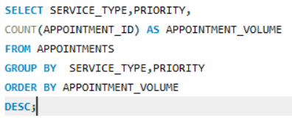
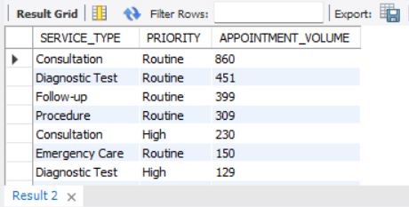
● Compare appointments across service types and priorities.
Query :
Output :
Service & priority: Appointment demand differs across service types and priority levels, helping identify high-demand services and priority categories.

Slide 10
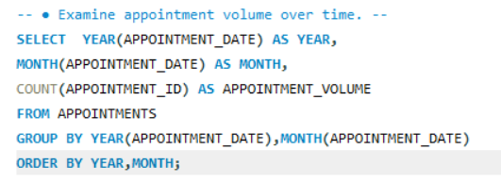
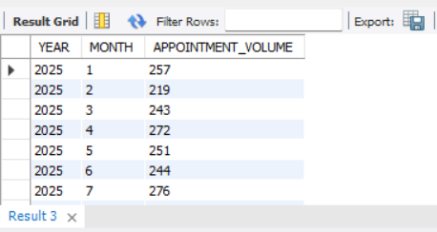
● Examine appointment volume over time.
Query :
Output :
● Time trends: Appointment volume changes over time, highlighting periods of higher or lower patient demand for better resource planning.

Slide 11
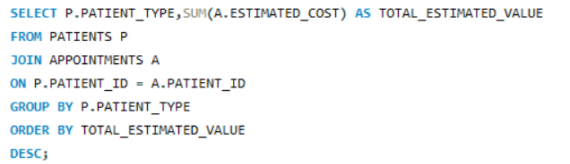
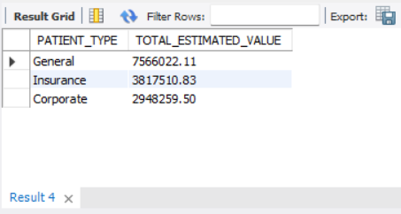
● Compare estimated appointment value across patient types.
Query :
Output :
Patient type: General, Corporate, and Insurance patients contribute different levels of estimated appointment value, showing differences in their business contribution.

Slide 12
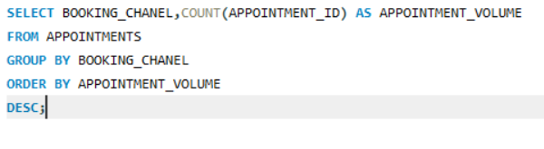
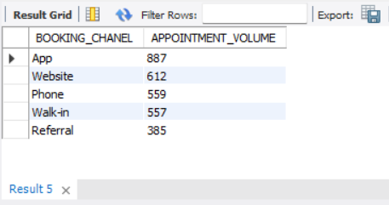
● Examine booking channels and their contribution to demand.
Query :
Output :
. Booking channels: Appointment demand is distributed across multiple booking channels, helping identify the channels most frequently used by patients.

Slide 13
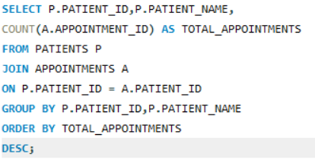
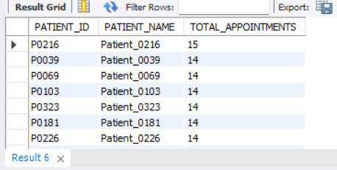
2. Understand Patient Appointment Behaviour
● Compare patients by number of appointments
Query :
Output :
Appointment frequency: Some patients show higher appointment activity, indicating a group of more frequently engaged patients.

Slide 14
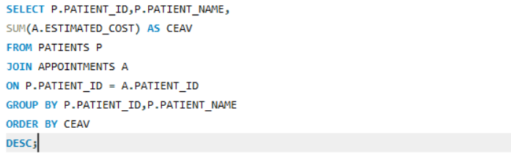
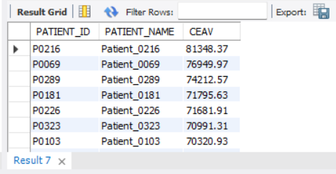
● Identify patients with higher cumulative estimated appointment value.
Query :
Output :
Cumulative value: Patients with multiple appointments can contribute higher cumulative estimated appointment value, making them important for understanding patient demand.

Slide 15
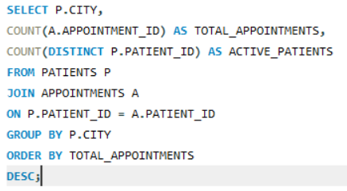
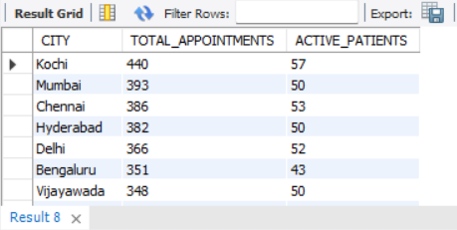
Compare patient activity across cities.
Query :
Output :
City-wise activity: Patient appointment activity varies across cities, highlighting differences in patient engagement and healthcare demand.

Slide 16
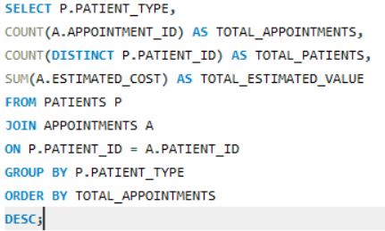
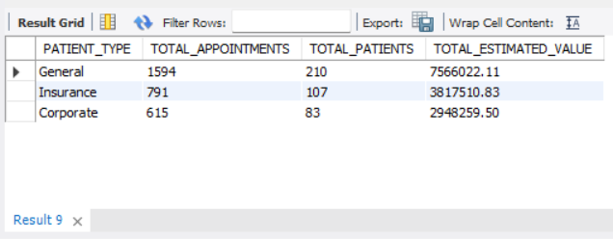
● Compare General, Corporate, and Insurance patients.
Query :
Output :
Patient type: General, Corporate, and Insurance patients show different appointment activity patterns, helping understand the behaviour of each patient segment.

Slide 17
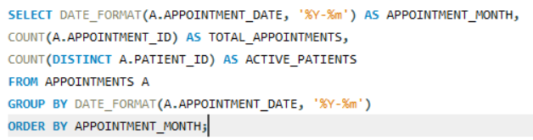
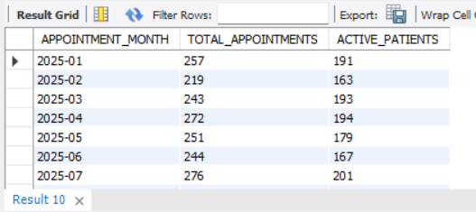
● Examine patient booking patterns over time.
QUERRY :
OUTPUT:
Booking trends: Patient booking activity changes over time, helping identify periods of increased or reduced patient engagement.

Slide 18
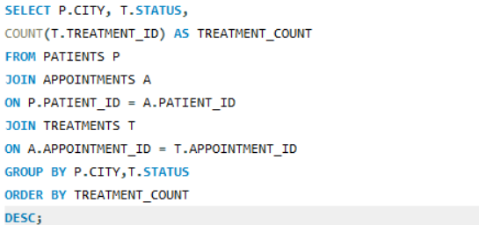
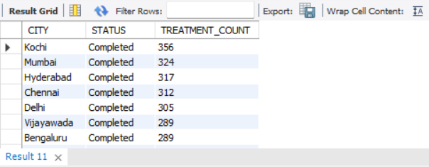
3 Evaluate Treatment Performance :
● Compare treatment outcomes across cities.
Query :
Output :
. City-wise outcomes: Treatment performance varies across cities, with differences in treatment activity and outcome patterns.

Slide 19
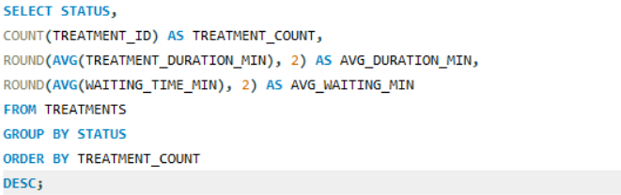
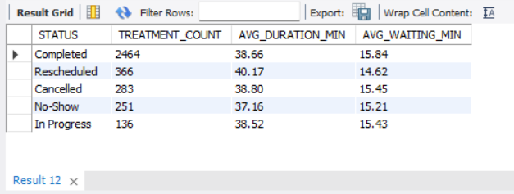
● Examine treatment duration and waiting time.
Query :
Output :
. Duration & waiting time: Treatment duration and patient waiting time vary across treatments, highlighting opportunities to improve operational efficiency.

Slide 20
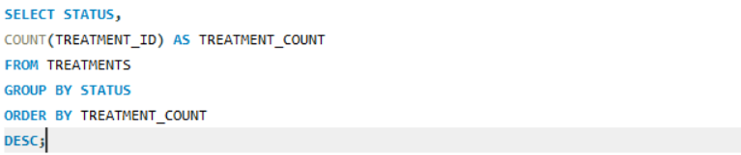
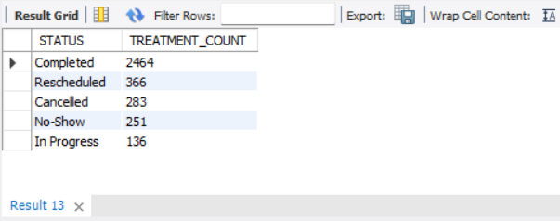
● Compare Completed, Cancelled, No-Show, Rescheduled, and In Progress outcomes.
Query :
Output :
Treatment outcomes: Completed, Cancelled, No-Show, Rescheduled, and In Progress treatments show different frequencies, helping identify the most common outcomes.

Slide 21
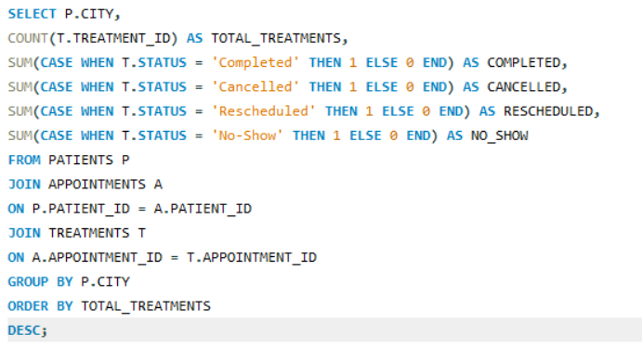
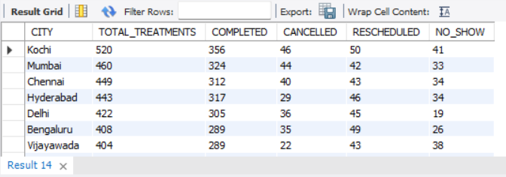
● Identify areas with higher treatment activity or poorer outcomes.
QUERY:
OUTPUT:
Problem areas: Cities or service areas with higher treatment activity and a greater number of negative outcomes require closer operational monitoring.

Slide 22
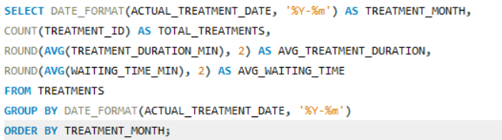
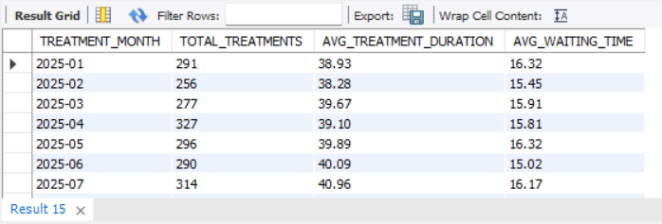
● Compare treatment performance over time.
QUERY:
OUTPUT:
Performance over time: Treatment activity, duration, and waiting time change over time, helping management identify performance trends and periods requiring improvement.

Slide 23
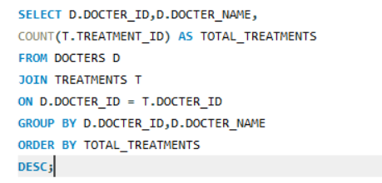
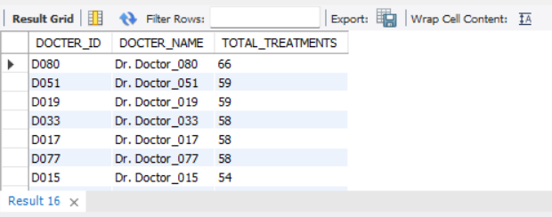
4. Understand Doctor and Room Performance
● Compare the number of treatments handled by doctors.
Query :
Output :
Doctor workload: The number of treatments handled varies across doctors, highlighting differences in workload and treatment activity.

Slide 24
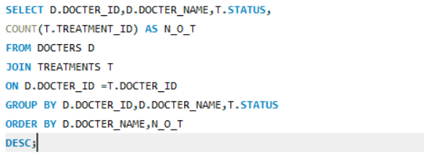
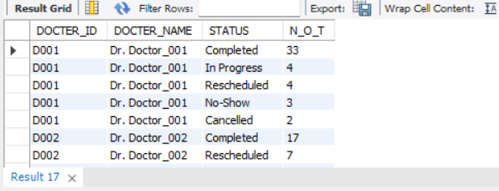
● Compare doctor performance across treatment outcomes.
Query :
Output :
Doctor outcomes: Treatment outcomes differ across doctors, helping identify variations in completed, cancelled, no-show, and other treatment statuses.

Slide 25
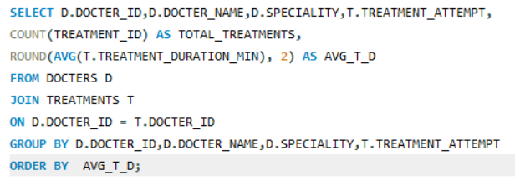
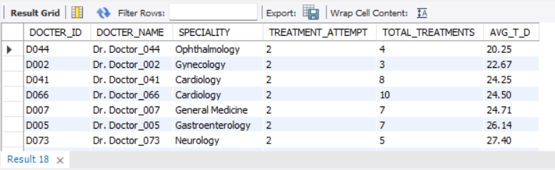
● Examine treatment duration across doctors.
Query :
Output :
Treatment duration: Average treatment duration varies between doctors, providing insights into differences in treatment workload and operational efficiency.

Slide 26
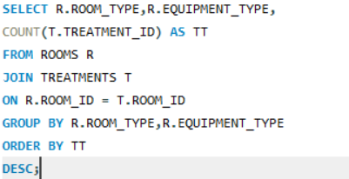
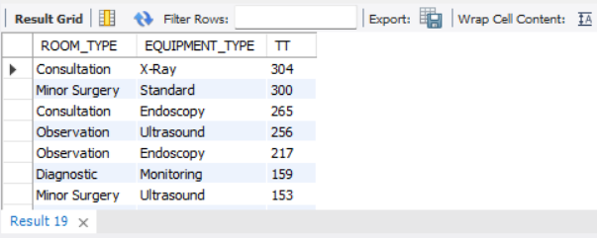
● Compare room usage across room types and equipment types.
Query :
Output :
Room & equipment usage: Room utilization differs across room types and equipment types, helping identify frequently used and less-used resources.

Slide 27
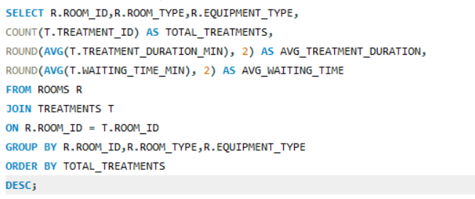
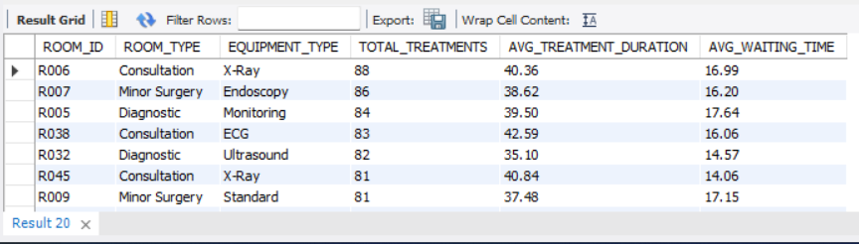
● Evaluate treatment performance across rooms.
Query :
Output :
Room performance: Treatment duration and waiting time vary across rooms, indicating opportunities to improve room allocation and operational efficiency.

Slide 28
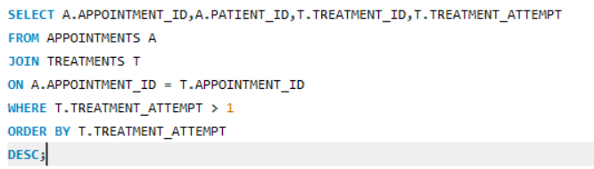
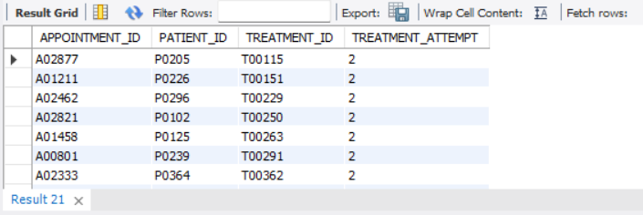
5. Identify Treatment and Appointment Problems
● Identify appointments requiring multiple treatment attempts.
Query :
Output :
Multiple attempts: Some appointments require more than one treatment attempt, indicating cases that may need additional operational attention.

Slide 29
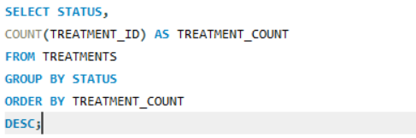
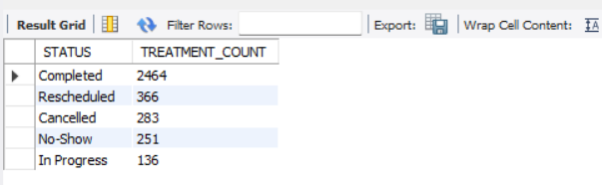
● Find common problem statuses and patterns.
Query :
Output :
Problem statuses: Cancellations, no-shows, and rescheduling represent key operational issues that can affect treatment efficiency and resource utilization

Slide 30
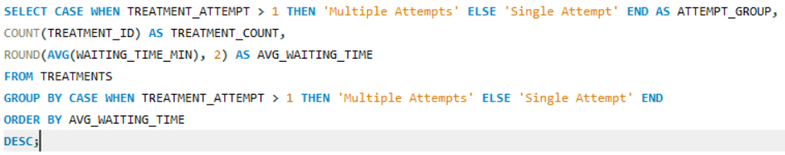
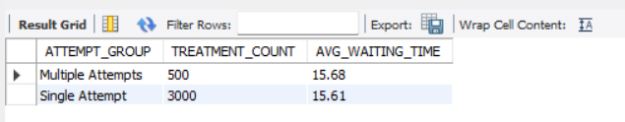
● Compare waiting time for appointments with multiple attempts.
Query :
Output :
. Waiting time: Comparing waiting times between single- and multiple-attempt treatments can reveal whether repeated attempts are associated with longer patient waiting times..

Slide 31
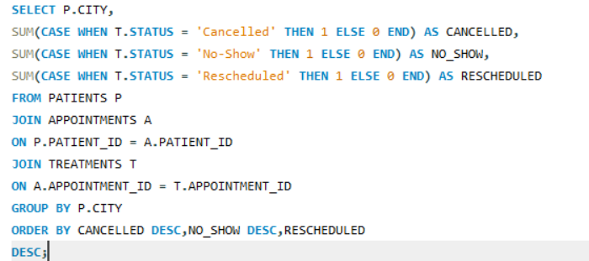
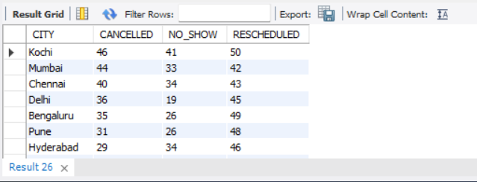
● Identify cities or service types with more cancellations, no-shows, or rescheduling.
Query :
Output :
City & service patterns: Differences in cancellations, no-shows, and rescheduling across cities or service types can help identify areas requiring operational improvement.

Slide 32
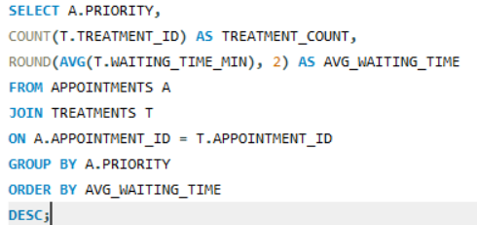
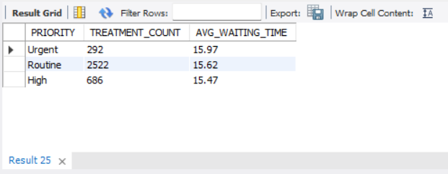
● Investigate whether priority level is associated with waiting time or treatment outcomes.
QUERY:
OUTPUT:
. Priority analysis: Comparing priority levels with waiting time and treatment outcomes can help determine whether higher-priority appointments receive different operational treatment.

Slide 33


● Treatment Duration and waiting time:
Query :
Output:
This insight helps to understand the overall treatment efficiency and variation in patient waiting time.

Slide 34
Key Insights & Recommendations :
Analyzed patient demand across cities, service types, priorities, and booking channels.
Identified frequent and high-value patients based on appointment activity and estimated appointment value.
Evaluated treatment performance using treatment outcomes, waiting time, and treatment duration.
Compared doctor workload and performance based on treatments handled and recorded ratings.
Analyzed room and equipment utilization across different treatment activities.
Identified operational problems such as cancellations, no-shows, rescheduling, and multiple treatment attempts
Improve resource allocation by assigning doctors, rooms, and equipment based on demand and utilization patterns.
Reduce patient waiting time by identifying services and time periods with higher waiting times.
Focus on frequent and high-value patients to improve patient engagement and service experience.
Reduce cancellations and no-shows through better appointment management and follow-up processes.
Review multiple-treatment cases to identify possible process issues and improve treatment efficiency.
Monitor doctor and room performance regularly to identify workload imbalances and improve overall hospital operations.

Slide 35
Challenges / Experiences:
Understanding relationships between tables.
Writing joins across multiple tables.
Using aggregation functions correctly
Learned real-time database design
Converting business requirements into SQL queries.
Interpreting SQL results from an operational perspective.
Converting query results into business insights
Providing data-driven recommendations for hospital management
These challenges were solved using Primary Keys, Foreign Keys, JOIN operations, GROUP BY, SUM(), AVG(), and COUNT() functions.

Slide 36
Conclusion :
The project successfully uses MySQL and SQL to analyze hospital patient-care operations and convert relational data into meaningful insights.
Patient and appointment analysis helps understand demand, booking behaviour, patient types, cities, and appointment patterns.
Treatment analysis provides insights into waiting time, treatment duration, multiple attempts, and different treatment outcomes.
Doctor and room analysis helps understand treatment workload, doctor performance, room utilization, and equipment usage.
The overall analysis supports better resource planning, operational improvement, and data-driven decision-making in hospital management.

Slide 37

THANK YOU

